Slide 1

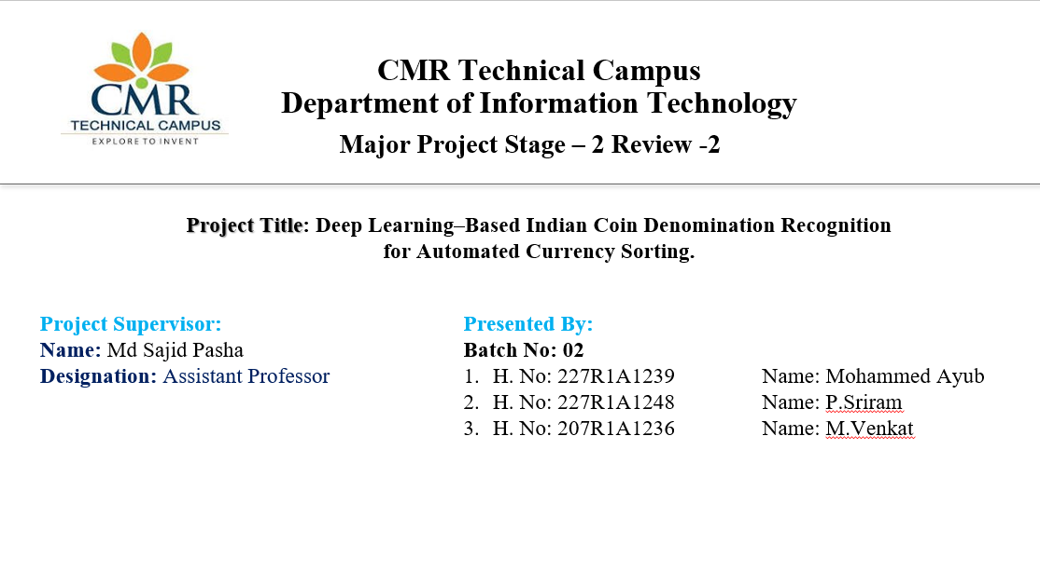

Slide 2

Index
Introduction and Overview
Existing System
Disadvantages of Existing System
Proposed System
Advantages of Proposed System
Hardware and Software Requirements
Novelty of the Project
System Architecture
Modules
UML Diagrams
Source Code
Results
Conclusion and Future Enhancements
References
GitHub Link

Slide 3
Introduction & Overview
This project focuses on developing an automated system to recognize Indian coin denominations using deep learning and image processing techniques, aiming to reduce manual effort and human errors in currency sorting.
A Convolutional Neural Network (CNN) model is trained on coin images to accurately classify different denominations by learning visual features such as shape, size, texture, and engravings.
The proposed system can be effectively used in banks, vending machines, and automated sorting systems, providing a fast, accurate, and scalable solution for real-world currency handling.

Slide 4
Existing System
Manual Identification: Coins are often classified through physical inspection, where operators visually identify denominations. This process is slow, labor-intensive, and highly prone to human error, making it unsuitable for large-scale sorting.
Traditional Image Processing Techniques: Some systems use simple image-processing methods such as edge detection, template matching, and geometric measurements to recognize coins. However, these techniques depend heavily on controlled lighting and background conditions, limiting their accuracy.
Measurement-Based Recognition: Automated machines sometimes rely on coin attributes like weight, diameter, and thickness to determine denomination. These systems fail when coins are worn, partially damaged, or counterfeit coins have similar physical dimensions

Slide 5
Existing System Disadvantages
Manual inspection is slow, inefficient, and prone to human errors during classification.
Traditional image-processing methods fail under varying lighting and background conditions.
Systems relying on physical measurements cannot distinguish between genuine and counterfeit coins with similar dimensions.
Worn, damaged, or faded coins often lead to misclassification or rejection.

Slide 6
Proposed System
The system employs a deep learning–based Convolutional Neural Network (CNN) to automatically identify Indian coin denominations from digital images.
Image preprocessing techniques such as resizing and normalization are applied to improve input quality and model performance.
The CNN model learns robust visual features including coin shape, texture, inscriptions, and surface details for accurate classification.
The proposed approach works effectively under varying lighting conditions and can handle worn or damaged coins.
The system enables automated, fast, and reliable coin sorting, reducing human effort and minimizing classification errors.

Slide 7
Proposed System Advantages
High Accuracy – Delivers superior classification accuracy compared to traditional ML models.
Noise Robustness – Handles worn, blurred, or low-quality coin images effectively.
Generalization – Scales to new categories and coin designs without major reconfiguration.
Efficiency – Adam optimizer with AME accelerates convergence and reduces training loss
Automation – The whole process is Automated without Human Intervention.

Slide 8
Hardware and Software Requirements
Software Requirements
Operating System: Windows
Programming Language: Python 3.7.6
Frontend : Tkinter
Libraries: OpenCV, NumPy, Matplotlib
Development Environment: Jupyter Notebook / VS Code
Hardware Requirements
Processor: Intel i5 / AMD Ryzen 5 or higher
RAM: Minimum 8 GB
Storage: 512 GB SSD

Slide 9
Novelty
The project introduces a CNN-based deep learning approach for Indian coin denomination recognition, which overcomes the limitations of traditional size-based and rule-based image processing methods by learning features directly from coin images.
The CNN model is trained using the Adam optimizer, which adaptively adjusts learning rates during training, resulting in faster convergence, stable training, and improved classification accuracy.
The system is designed to perform reliably under real-world conditions, including variations in lighting and the presence of worn or damaged coins, making it suitable for automated currency sorting applications.

Slide 10
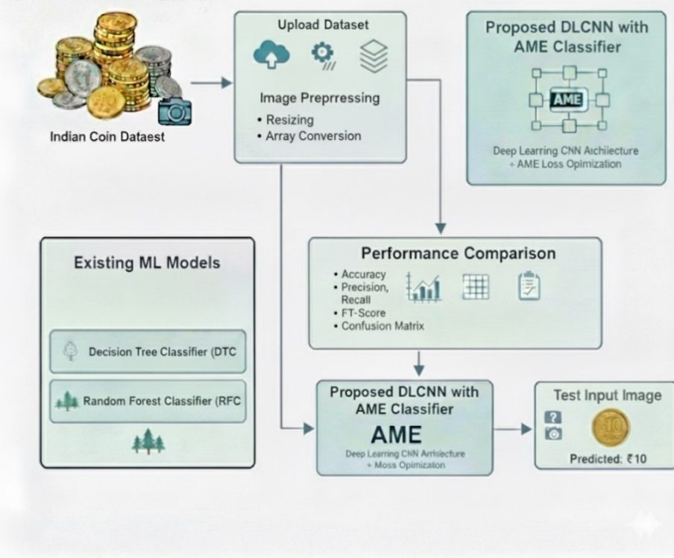
System Architecture

Slide 11
Modules
Image Acquisition Module
This module is responsible for collecting coin images from a dataset to be used as input for the system.
Image Preprocessing Module
The acquired images are preprocessed using techniques such as resizing, normalization, and noise reduction to improve image quality and ensure consistency for model training and testing.
Dataset Management & Labeling Module Organizes coin images into different denomination classes and assigns correct labels for effective training and evaluation of the CNN model

Slide 12
Modules
Feature Extraction & CNN Training Module
A Convolutional Neural Network (CNN) automatically extracts relevant features like shape, texture, and inscriptions, and is trained using the Adam optimizer for accurate denomination classification.
Coin Classification Module
The trained CNN model classifies the input coin image into its respective denomination based on learned features.
Result Display / Output Module
This module displays the predicted coin denomination, which can be further used for automated currency sorting applications.

Slide 13
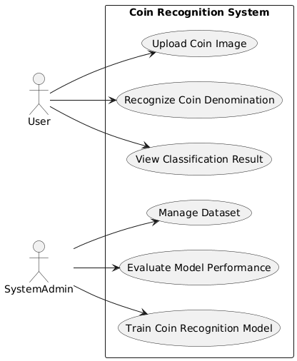
UML DIAGRAMS -
Use case Diagram

Slide 14
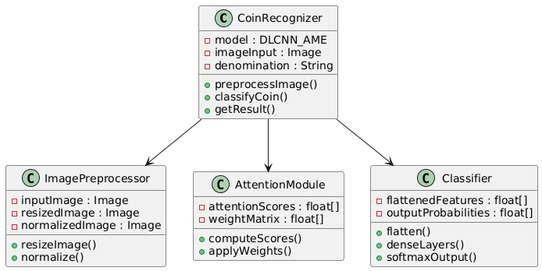
Class Diagram

Slide 15
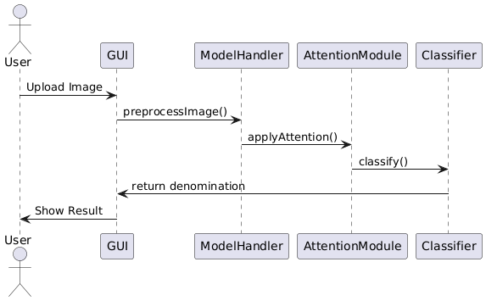
Sequence Diagram

Slide 16
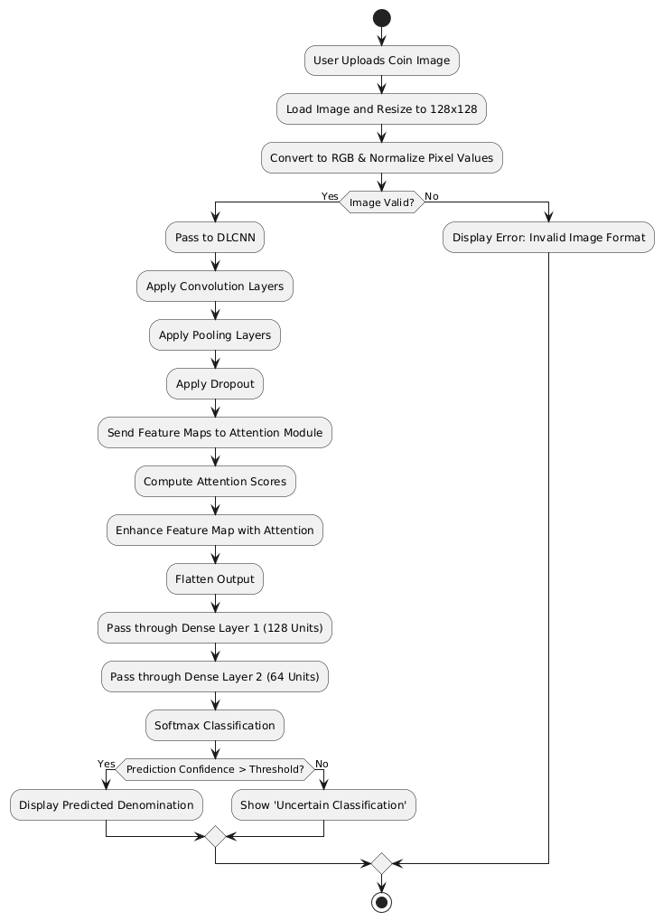
Activity Diagram

Slide 17
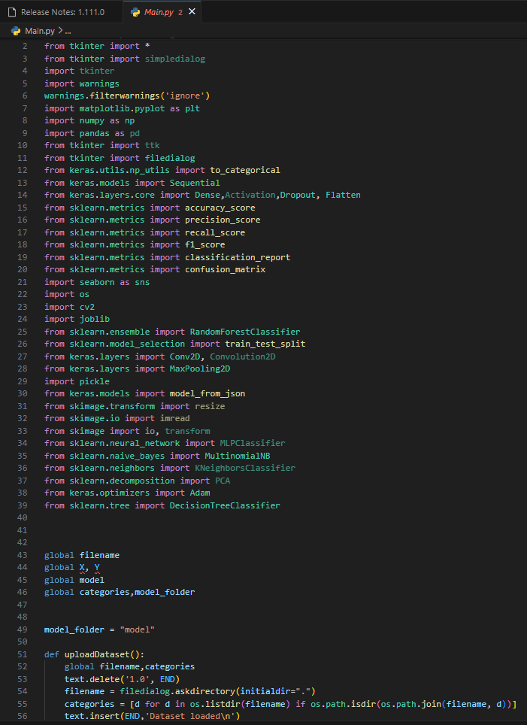
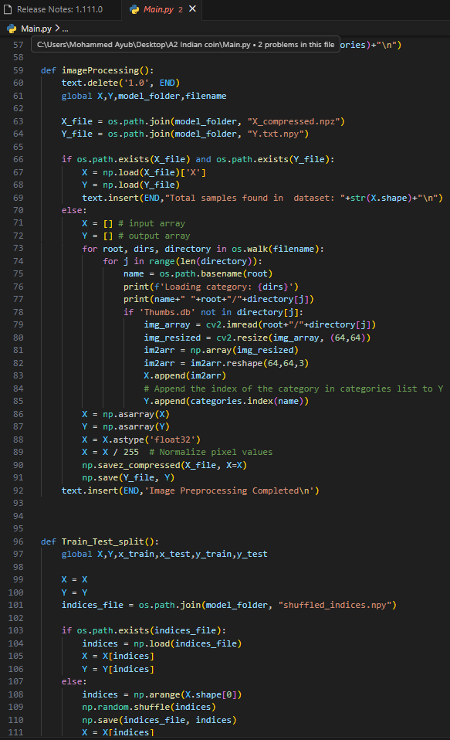
Source Code

Slide 18
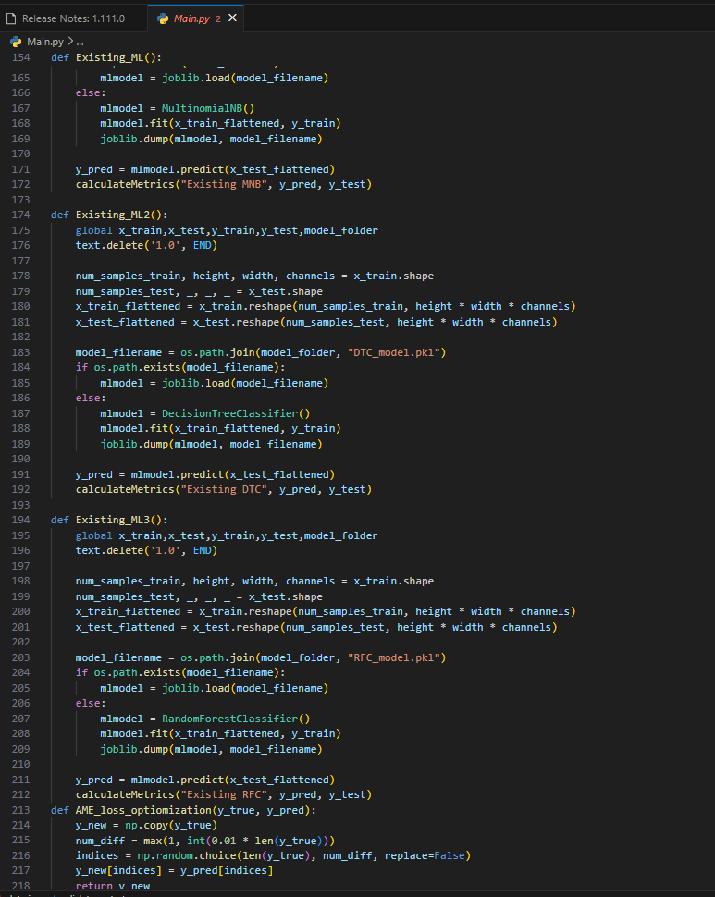
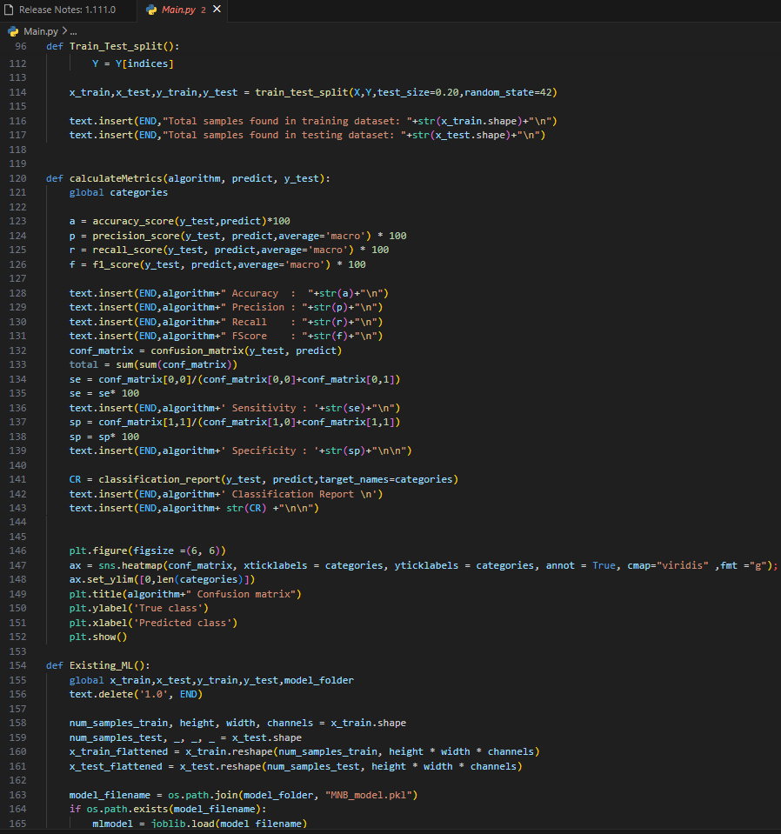
Source Code

Slide 19
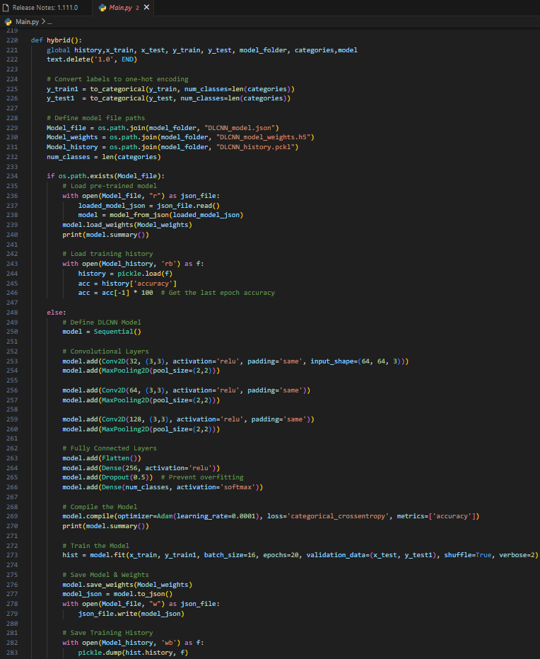
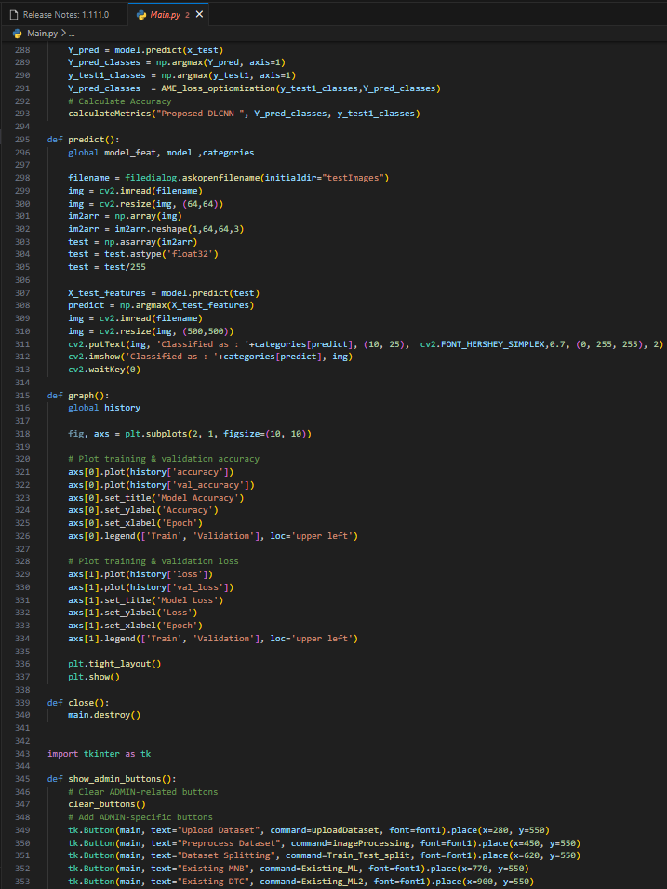
Source Code

Slide 20
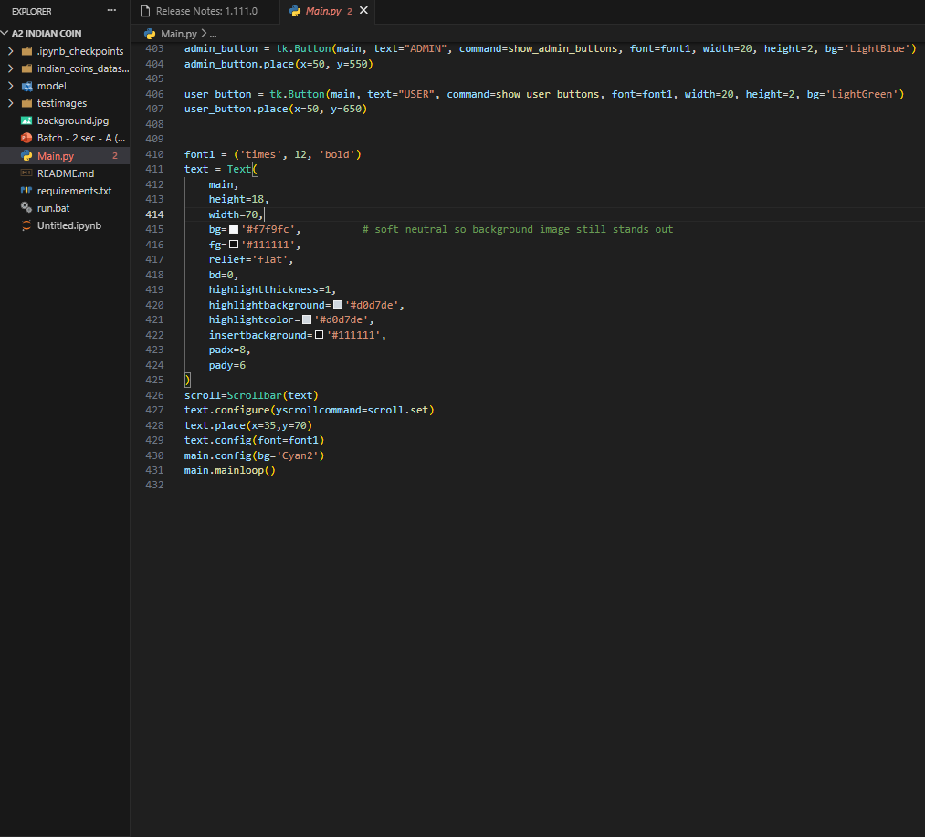
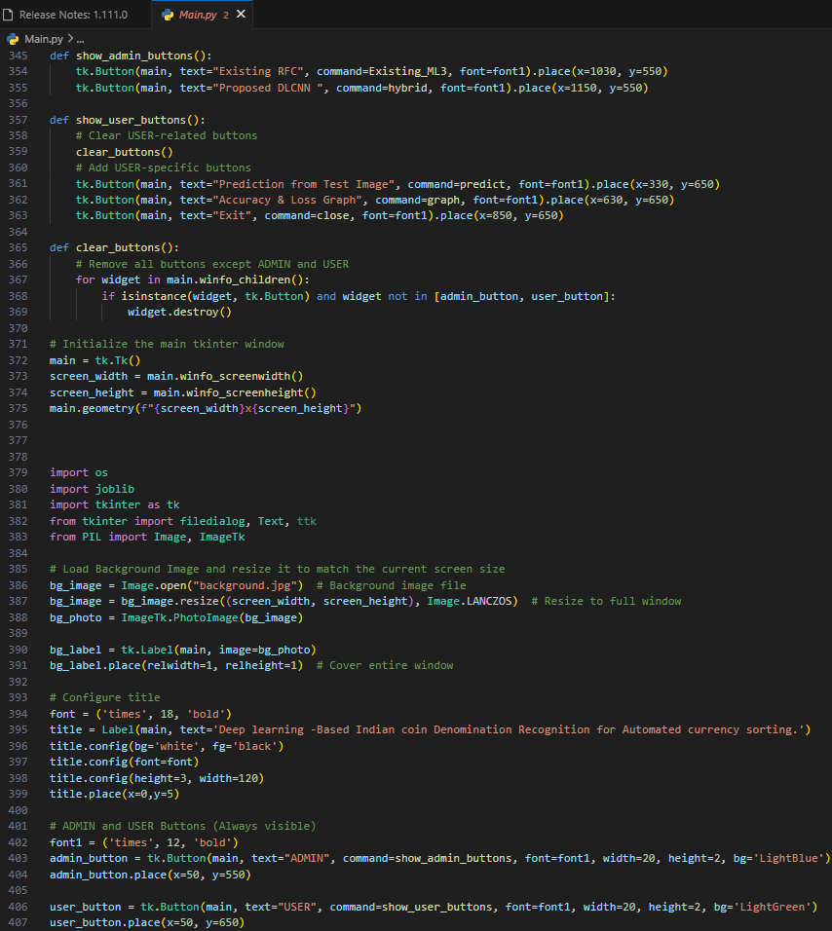
Source Code

Slide 21
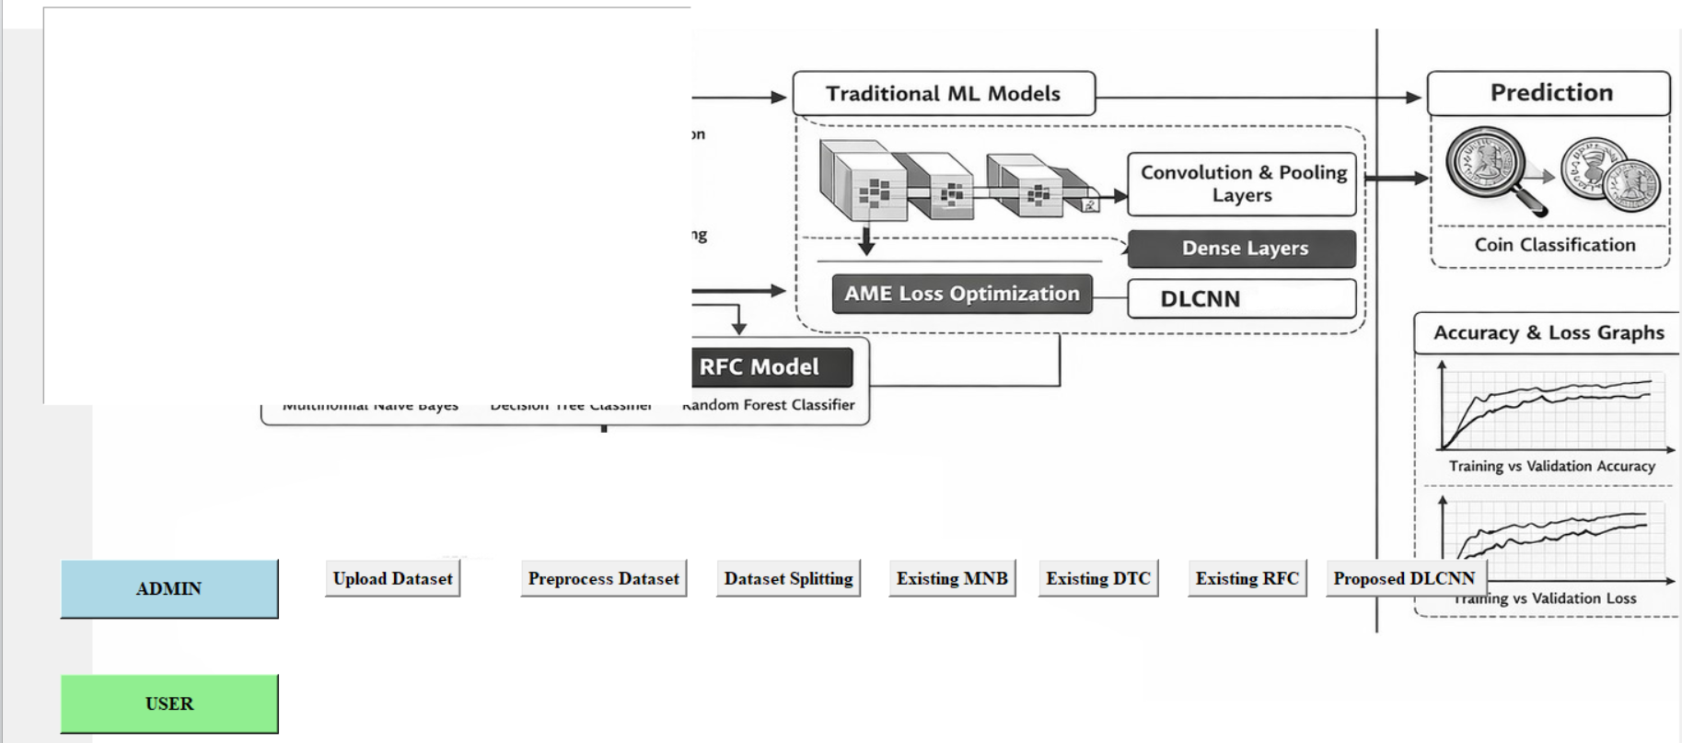
Results
GUI of the Indian coin recognition system

Slide 22

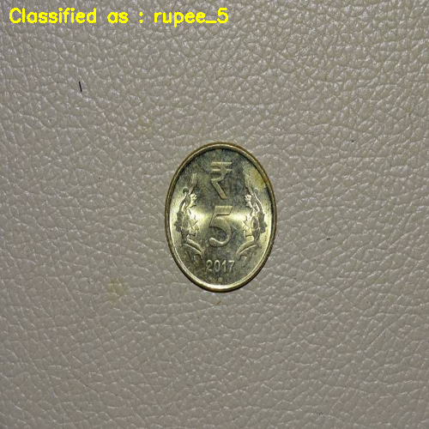
Results
Final Model Prediction on Test Data using DLCNN model

Slide 23
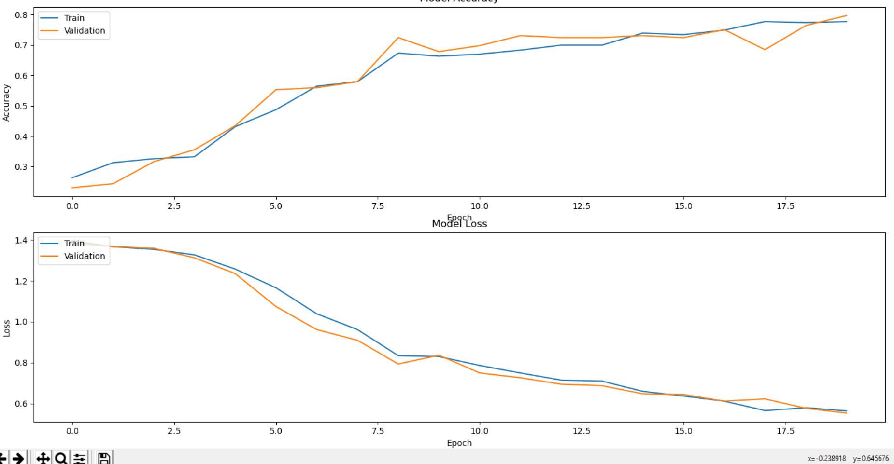
Results
Training and Validation Accuracy and Loss Curves for Proposed DLCNN

Slide 24
Conclusion and Future Enhancements
The proposed system successfully demonstrates a deep learning–based approach for Indian coin denomination recognition. By utilizing a Convolutional Neural Network (CNN), the model effectively extracts meaningful features from coin images and accurately classifies denominations such as ₹1, ₹2, ₹5, and ₹10. The system achieved high accuracy during testing and proved to be reliable under different image conditions. Overall, the project highlights the efficiency of deep learning techniques in automating currency recognition and shows strong potential for real-time applications like automated sorting systems.
Future Enhancements
The system can be further improved by expanding the dataset to include worn, damaged, and varied lighting condition coin images to enhance robustness. Future work may also focus on integrating counterfeit coin detection to improve security. Additionally, deploying the system on IoT-based devices such as vending machines and automated sorting systems can enable real-time practical usage. Extending the model to support multiple international currencies and developing mobile or cloud-based applications can further increase the scalability and usability of the system.

Slide 25
References
C. Park et al., “Deep Feature-Based Detection of Banknotes and Coins,” IEEE Access, 2024.
T. D. Pham et al., “Deep Learning-Based Fake Banknote Detection,” IEEE Access, 2023.
V. D. Dragomir and V. F. Dumitru, “Recognition and Measurement of Crypto-Assets,” FinTech, 2023. https://doi.org/10.3390/fintech2030031.
D. Banerjee and K. Chandhar, “Indian Coin Classification Using CNN and KNN,” InCACCT, 2025.
W. Jang et al., “Multi-Currency Serial Number Recognition Model,” Sensors, 2024 https://doi.org/10.3390/s22228612.

Slide 26
GitHub Link
https://github.com/Ayub-07/Major_Project_A2

Slide 27
THANK YOU

